Slide 1

MINI PROJECT- II
COURIER MANAGEMENT SYSTEM
(2020-2021)
Department of Computer Engineering and Applications

Slide 2
Submitted By:
Ayushi Maheshwari (181500183)
Deepanshi Garg (181500206)
Esha Gupta (181500229)
Megha Kansal (181500382)
Rishabh Garg (181500562)
Supervised By:
Mr. Anand Parkash Gupta
Asst. Professor Department of Computer Science & Applications
And
Mrs. Ruchi Gupta
Asst. Professor Department of Computer Science & Applications

Slide 3
Introduction
The Courier Management System is a simple project that helps a courier company or businesses manage their customers' parcels or packages details.
The system stores all the branches or the company that can be also used when setting a destination where the recipient will pick up their packages or parcels.
The system has a tracking feature where can help to monitor the movement of the customer's parcel.
The system has 2 types of user which is the Admin user and the Branch Staff user. The Admin user can manage all the data in the system including managing the branches and branches staff user. The Branch user can only track a parcel and manage the list of parcels where the origin or the destination of a parcel under the logged-in staff branch.

Slide 4
The couriered items have multiple statuses which are the "Item Accepted by Courier", "Collected", "Shipped", "In-Transit", "Arrived At Destination", "Out for Delivery", "Ready to Pickup", "Delivered", "Picked-up", and "Unsuccessful Delivery Attempt". These statuses will help to determine the movement of the parcel.
The system also generates a report between two dates and selected status. The couriered items of the clients can be set into "Deliver" and "Pickup".
The parcels that marked as "Deliver" are the items to be delivered directly to the recipient while the "Pickup" will be delivered to the branch of the company near to the recipient address.

Slide 5
Objective
Nowadays, people are very busy and they don’t find much time to go to a dealer to get products. But they need to buy products. And most of the people are accessing Internet.
Courier services became increasingly popular with the arrival of Internet shopping. Being able to order large and multiple items from online sellers required specialist delivery services that would enable customers to not only receive their items but also enable online sellers to offer things such as next day delivery. Something that is only possible with a courier service.

Slide 6
Technologies Used
The Courier Management System was developed using HTML, PHP/MySQLi, CSS, JavaScript (jQuery/Ajax),and Bootstrap for the design.
HTML: HTML stands for Hypertext Markup Language, and it is the most widely used language to write Web Pages. As its name suggests, HTML is a Markup Language which means you use HTML to simply "mark-up" a text document with tags that tell a Web browser how to structure it to display.
CSS: CSS is used to define styles for your web pages, including the design, layout and variations in display for different devices and screen sizes.

Slide 7
JavaScript: JavaScript is a text-based programming language used both on the client-side and server-side that allows you to make web pages interactive. Where HTML and CSS are languages that give structure and style to web pages, JavaScript gives web pages interactive elements that engage a user.
Bootstrap: Bootstrap is a potent front-end framework used to create modern websites and web apps. It's open-source and free to use, yet features numerous HTML and CSS templates for UI interface elements such as buttons and forms. Bootstrap also supports JavaScript extensions.
PHP: PHP is a recursive acronym for "PHP: Hypertext Preprocessor". PHP is a server side scripting language that is embedded in HTML. It is used to manage dynamic content, databases, session tracking, even build entire e-commerce sites.

Slide 8
SQL Server: The SQL Server is a relational database management system from Microsoft. The system is designed and built is to manage and store information. The system supports various business intelligence operations, analytics operations, and transaction processing.

Slide 9
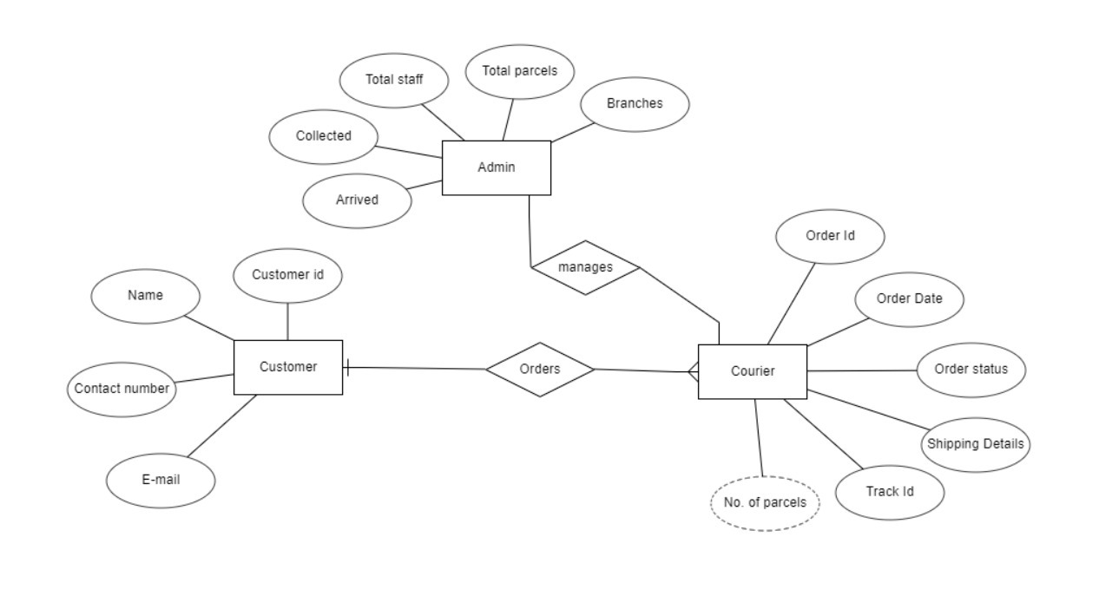
E-R Diagram

Slide 10
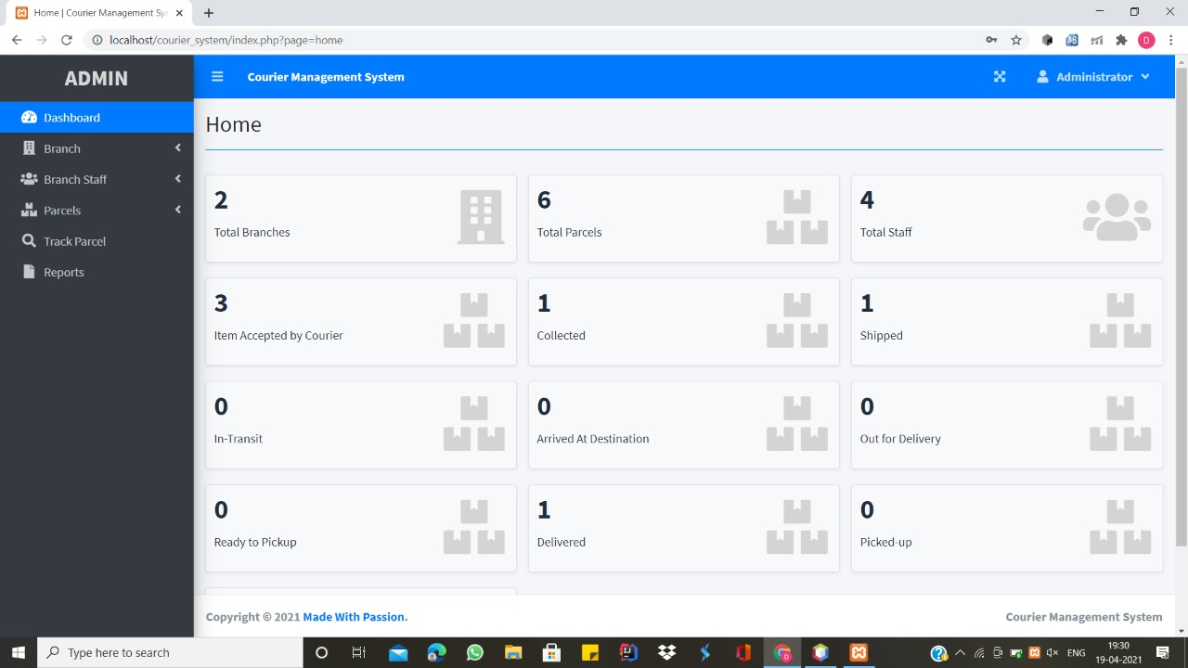
Screenshot Of Front Page

Slide 11
Conclusion
The entire project has been developed and deployed as per the requirements stated by the user, it is found to be bug free as per the testing standards that is implemented.
Any specification-untraced errors will be concentrated in the coming versions. The system needs more elaborative technicality for its inception and evolution.

Slide 12
References
We referred to the following resources:-
https://www.w3schools.com/
https://www.beta-labs.in/
https://www.phptpoint.com/
https://www.mysql.com/
YouTube videos

Slide 13
THANK YOU

